Slide 1

Bacchus Winery
Group 2
Romany Manriquez
Outhayvanh Somchaleun
Kristina Vasquez
Group 2
Bacchus Winery

Slide 2
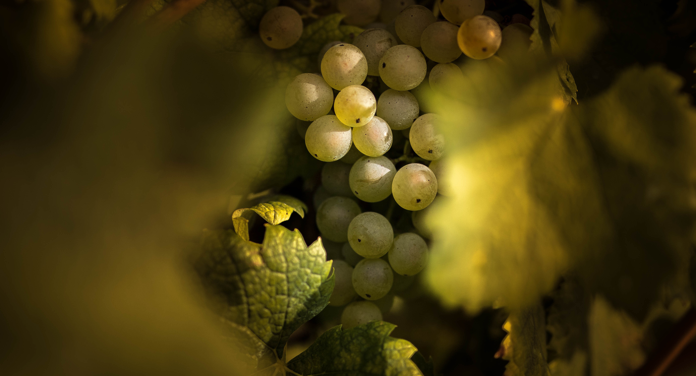

Agenda
About the Case Study
Business Rules
Our Solution
Reports
Group 2
Bacchus Winery

Slide 3
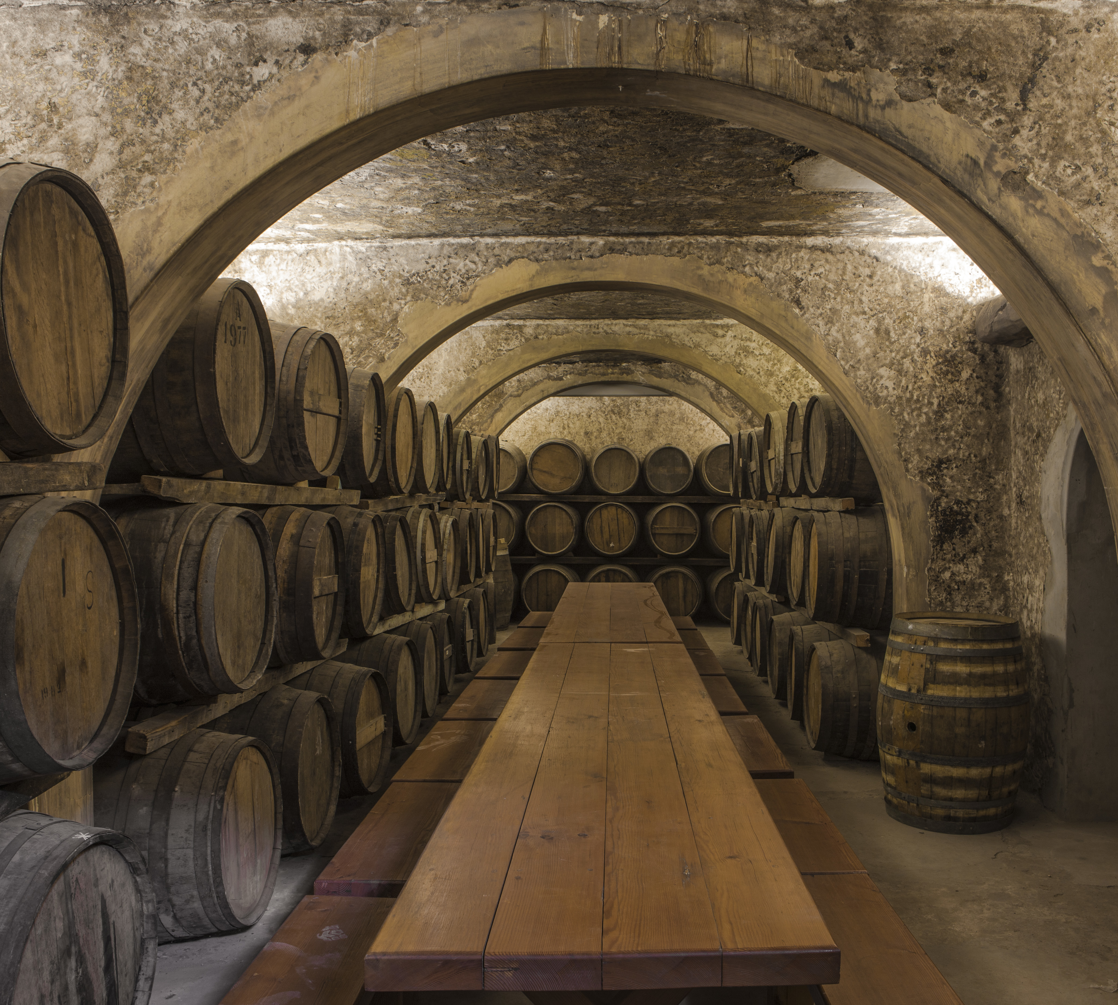
About the Case Study
Three years ago, the Bacchus brothers, Stan and Davis, inherited their father’s winery. They are both anxious and excited to implement new business methods to help improve their products and customer service. They decided to keep the current staff their father originally hired and would like to introduce new business practices, like online ordering, to help keep track of shipments and distribution.
Group 2
Bacchus Winery

Slide 4
Meet the Team
Owners: Stan and Davis Bacchus
Finances and Pay roll: Janet Collins
Marketing: Roz Murphy and Bob Ulrich (assistant)
Production line: Henry Doyle (manager)
Distribution: Maria Costanza
Group 2
Bacchus Winery

Slide 5

Business Rules

Slide 6




Business Rules
Looking to incorporate new business practices to improve customer service and the quality of the products
Winery produces 4 types of wine using grapes grown on-site:
Merlot, Cabernet, Chablis, and Chardonnay
Quarterly reports are needed to review the following:
Supplier delivery performance, Wine distribution and employees work hours.
Supplies is sourced from 3 different suppliers.
Would like to use online resources to improve supply, tracking and ordering from the suppliers as well as distributors can order and track shipments with ease.
Use of online resources
Group 2
Bacchus Winery

Slide 7
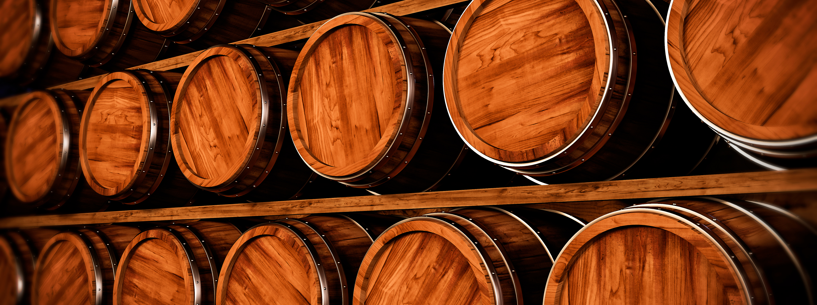
Our Solution

Slide 8
ERD Components
Suppliers
Inventory
Each supplier is responsible for delivering specific components required for winemaking.
Supplier 1 – Corks and Bottles
Supplier 2 – Labels and Boxes
Supplier 3 – Vats and Tubing
Need to keep track of supplier info:
name, contact information, pricing, etc
Keep track of stock on materials and good requires for winemaking. This includes the different grape varieties and materials from the suppliers.
Each grape variety has its own inventory and is associated with a unique identifier, allowing for accurate tracking and management of stock levels.
Record delivery details for each component (supplier, quantity, delivery date).
Group 2
Bacchus Winery

Slide 9
ERD Components (continued)
Wine Production
Distribution
Employees
There are 4 different grape varieties used for different types of wine:
Merlot, Cabernet, Chablis, Chardonnay
Production line managers fulfill the following tasks:
oversee the production line, scheduling production runs, allocating resources, and ensuring adherence to quality standards and production schedules.
Production records include details of each production batch, including production dates.
Each type of wine requires specific components (grape, bottle, corks, labels).
Track distribution of wines to various distributors.
Distributor profiles include company information, contact details, geographic coverage, sales territories, and contractual agreements.
Each distributor may carry multiple wines.
Shipment tracking allows distributors to monitor the status of their orders in real-time, providing transparency and improving customer satisfaction.
Record details of employees (name, role, contact information, etc.).
Timekeeping functionality captures employee work hours, including regular overtime, breaks, and absences.
Group 2
Bacchus Winery

Slide 10
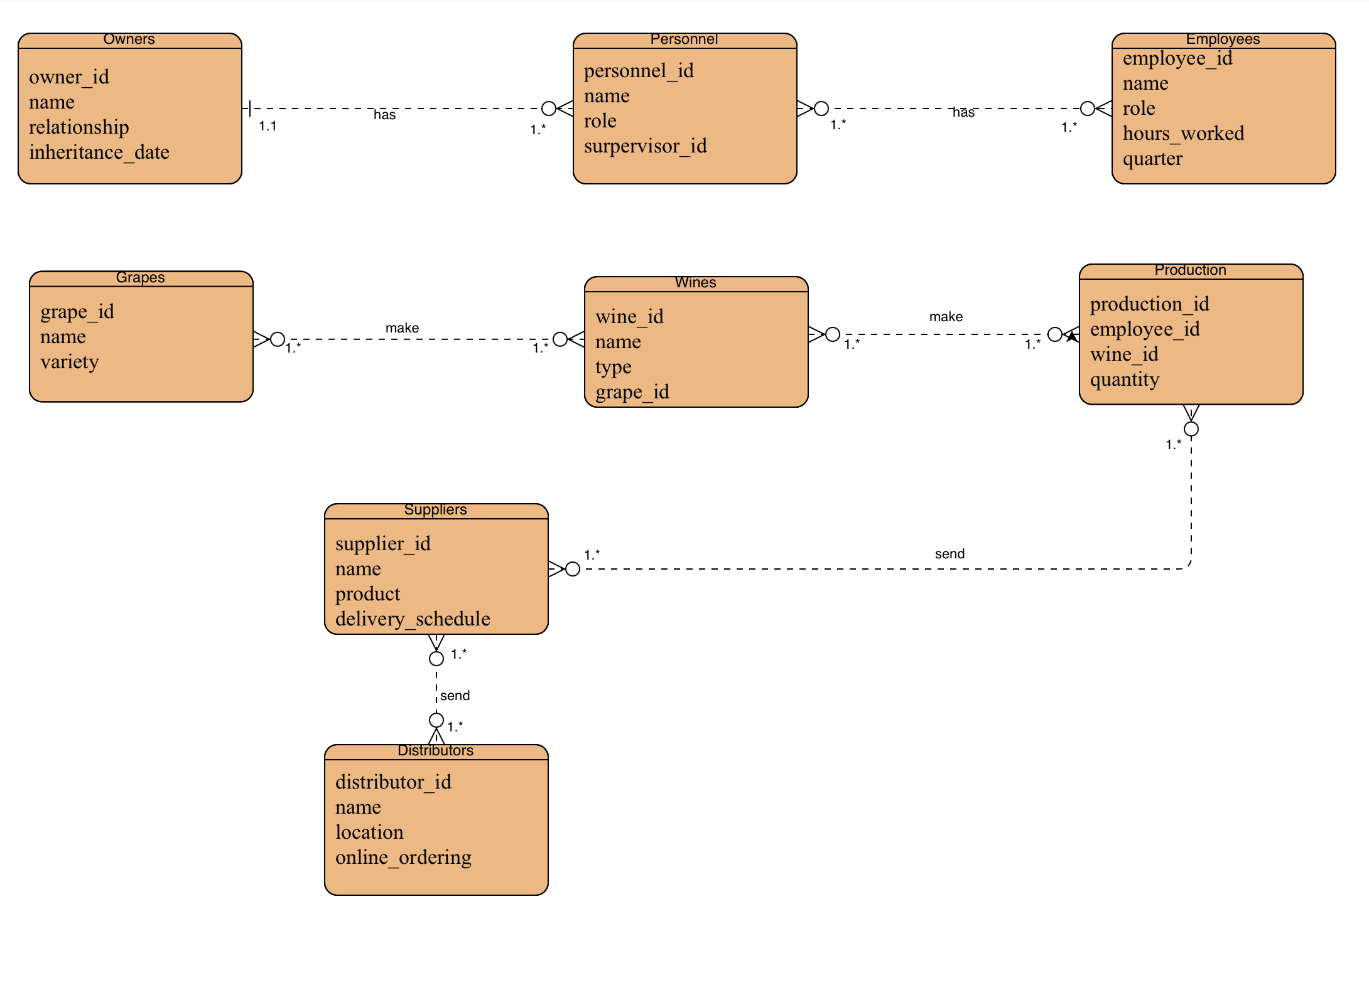
ERD
Group 2
Bacchus Winery

Slide 11

Reports

Slide 12
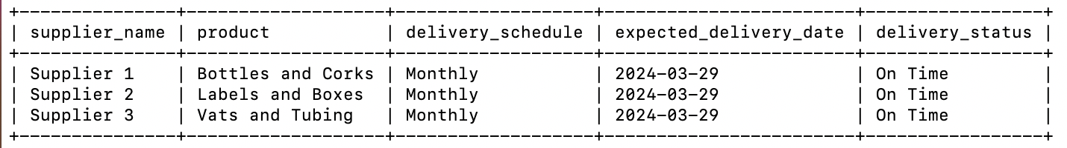
Bacchus Winery Supplies Inventory Report
This report provides an overview of the current inventory levels of the supplies and components required for winemaking.
It includes information about the quality of each item in stock and the delivery schedule for pending supplier orders.
By having detailed and accurate information about inventory levels, Bacchus Winery can ensure they have an adequate supply of materials to meet production requirements.
It also helps manage cash flow by avoiding overstocking or stockouts, optimizing storage space, and identifying any potential shortage or excess inventory that may impact production schedules and overall business performance.
Group 2
Bacchus Winery

Slide 13
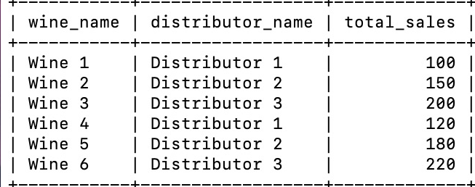
Bacchus Winery Distributor Report
This report provides a comprehensive overview of the Distributors and Distributors Sales at Bacchus Winery
The Distributor Report is essential for monitoring and optimizing the company’s sales. By analyzing sales data, Bacchus Winery can identify trends
Assess the efficiency of producing more sales, and make data driven decisions to improve quality reduce low selling products and enhance overall sales
Group 2
Bacchus Winery

Slide 14
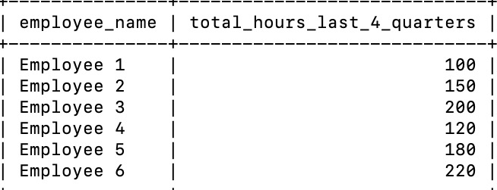
Bacchus Winery Employee Time Report
This report is crucial for the owners, Stan and Davis, to evaluate employee worked hours and ensure optimization utilization of the workforce resources. By analyzing employee work hours over multiple quarters, Bacchus Winery can identify trends, assess workload distribution, and address any issues related to employee productivity or scheduling. This information enables Bacchus Winery to make informed decisions regarding staffing levels, resource allocation, and employee management to improve overall efficiency and productivity.
Group 2
Bacchus Winery

Slide 15

Summary
With the right business practices and the utilization of online resources, Bacchus Winery can be successful and expand in the future.
Group 2
Bacchus Winery

Slide 16

Thank you
Fin!
Group 2
Bacchus Winery

